Slide 1
ENGT 4050 Senior Technology Capstone Spring 2014 Team B-12

Slide 2

Code TA Team B-12 Brandon Collins, Team Leader Stephen Wambui Sierra Linn Ben Morris

Slide 3

Outline
Background and Motivation
Summary
Details
Scope and Elements
Deliverables
Challenges
Timeline
Budget
Conclusion
Questions

Slide 4
Background and Motivation
Increased demand for technical and computer-based careers
Increased professor workload
A TA can provide support
Can the process be automated?

Slide 5
Summary
Web-based application
Organize assignments, students, etc.
Upload and automatically grade code
Improves:
Professor efficiency
Student feedback

Slide 6
Scope and Elements
Small, but scalable
Modular
Linux server
Github
Four elements:
Web front-end
Web back-end
Database
Server-side grading program

Slide 7
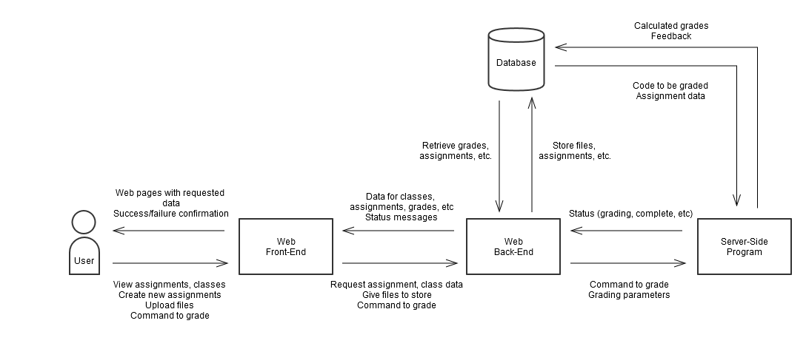
Scope and Elements

Slide 8
Deliverables
Website
Front-end
Back-end
Database
Server-side grading program

Slide 9
Deliverables
Website
Front-end
Everything the user sees
Direct interaction
Built with:
HTML
CSS
Graphics

Slide 10
Deliverables
Website
Back-end
Interfaces with other elements
Built with:
Python-Flask

Slide 11
Deliverables
Database
Collection of all user, class, assignment info
Maintenance code
Built with:
PostgreSQL
Python (maintenance code)

Slide 12
Deliverables
Server-side grading program
Compiles code
Runs code
Evaluates code
Built with:
Python

Slide 13
Challenges
Front-end
User-friendly
Multiple platforms
Database
Simplicity
Efficiency
Back-end, database maintenance, grading program
Maintainability
Scalability

Slide 14
Timeline
Database schema – 1 week
Web-end – 4 weeks
Database implementation – 1 week
Web back-end – 3 weeks
Server-side grading program – 4 weeks
Database management and support code – 2 weeks
User testing – 2 weeks
Integration testing – 2 weeks

Slide 15
Timeline

Slide 16
Budget
Web hosting
$5-$15/month
Domain name
~$10
Total estimated cost: $30-$70

Slide 17
Conclusion
Web-based grading application
Potential to improve professor efficiency
Modular
Scalable

Slide 18
Questions?

